Slide 1


http://www.comp.nus.edu.sg/~cs2100/
Lecture #3a
Data Representation and Number Systems

Slide 2
Questions?
Ask at https://sets.netlify.app/module/66988ae3322ba68d1103fdd4
OR
Scan and ask your questions here! (May be obscured in some slides)

Slide 3
Lecture #3: Data Representation and Number Systems (1/2)
Data Representation
Decimal (base 10) Number System
Other Number Systems
Base-R to Decimal Conversion
Decimal to Binary Conversion
5.1 Repeated Division-by-2
5.2 Repeated Multiplication-by-2
Conversion Between Decimal and Other Bases
Conversion Between Bases
Binary to Octal/Hexadecimal Conversion

Slide 4
Lecture #3: Data Representation and Number Systems (2/2)
ASCII Code
Negative Numbers
10.1 Sign-and-Magnitude
10.2 1s Complement
10.3 2s Complement
10.4 Comparisons
10.5 Complement on Fractions
10.6 2s Complement Addition/Subtraction
10.7 1s Complement Addition/Subtraction
10.8 Excess Representation
Real Numbers
11.1 Fixed-Point Representation
11.2 Floating-Point Representation

Slide 5
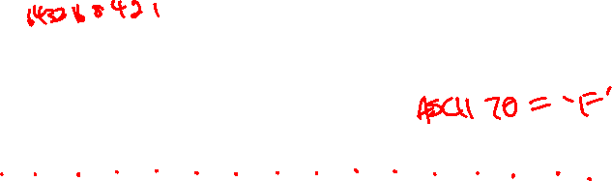
1. Data Representation (1/2)
Basic data types in C:
int
float
double
char
Variants: short, long
How data is represented depends on its type:
As an ‘int’, it is 70
01000110
As a ‘char’, it is ‘F’
11000000110100000000000000000000
As an ‘int’, it is -1060110336
As an ‘float’, it is -6.5

Slide 6

1. Data Representation (2/2)
Data are internally represented as sequence of bits (binary digits). A bit is either 0 or 1.
Other units
Byte: 8 bits
Nibble: 4 bits (rarely used now)
Word: Multiple of bytes (eg: 1 byte, 2 bytes, 4 bytes, etc.) depending on the computer architecture
N bits can represent up to 2^{N} values
Eg: 2 bits represent up to 4 values (00, 01, 10, 11); 4 bits represent up to 16 values (0000, 0001, 0010, …., 1111)
To represent M values, ⎡log₂M⎤ bits required
Eg: 32 values require 5 bits; 1000 values require 10 bits

Slide 7
2. Decimal (base 10) Number System
A weighted-positional number system.
Base (also called radix) is 10
Symbols/digits = { 0, 1, 2, 3, 4, 5, 6, 7, 8, 9 }
Each position has a weight of power of 10
Eg: (7594.36)₁₀ = (7 × 10³) + (5 × 10²) + (9 × 10¹) + (4 × 10⁰) + (3 × 10⁻¹) + (6 × 10⁻²)
(a_{n}a_{n-1}… a₀ . f₁f₂ … f_{m})₁₀ = (a_{n} x 10^{n}) + (a_{n-1}x10^{n-1}) + … + (a₀ x 10⁰) + (f₁ x 10⁻¹) + (f₂ x 10⁻²) + … + (f_{m} x 10^{-m})

Slide 8
3. Other Number Systems (1/2)
Binary (base 2)
Weights in powers of 2
Binary digits (bits): 0, 1
Octal (base 8)
Weights in powers of 8
Octal digits: 0, 1, 2, 3, 4, 5, 6, 7.
Hexadecimal (base 16)
Weights in powers of 16
Hexadecimal digits: 0, 1, 2, 3, 4, 5, 6, 7, 8, 9, A, B, C, D, E, F.
Base/radix R:
Weights in powers of R

Slide 9
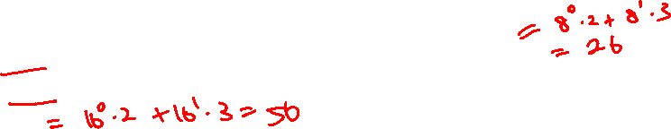
3. Other Number Systems (2/2)
In some programming languages/software, special notations are used to represent numbers in certain bases
In programming language C
Prefix 0 for octal. Eg: 032 represents the octal number (32)₈
Prefix 0x for hexadecimal. Eg: 0x32 represents the hexadecimal number (32)₁₆
In QTSpim (a MIPS simulator you will use)
Prefix 0x for hexadecimal. Eg: 0x100 represents the hexadecimal number (100)₁₆
In Verilog, the following values are the same
8’b11110000: an 8-bit binary value 11110000
8’hF0: an 8-bit binary value represented in hexadecimal F0
8’d240: an 8-bit binary value represented in decimal 240

Slide 10
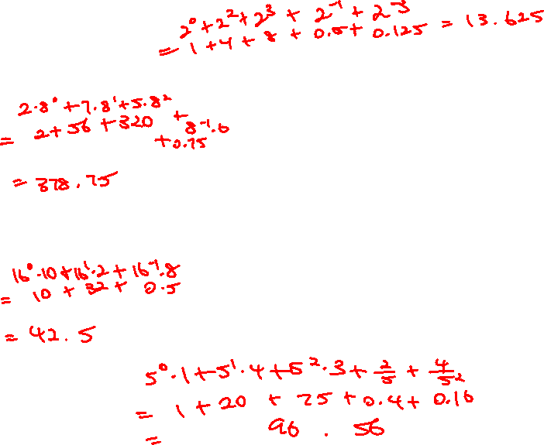
4. Base-R to Decimal Conversion
Easy!
1101.101₂ = 1×2³ + 1×2² + 1×2⁰ + 1×2⁻¹ + 1×2⁻³
= 8 + 4 + 1 + 0.5 + 0.125 = 13.625₁₀
572.6₈ =
5×8² + 7×8¹ + 2×8⁰ + 6×8⁻¹
= 320 + 56 + 2 + 0.75 = 378.75₁₀
2A.8₁₆ =
2×16¹ + 10×16⁰ + 8×16⁻¹
= 32 + 10 + 0.5 = 42.5₁₀
341.24₅ =
3×5² + 4×5¹ + 1×5⁰ + 2×5⁻¹ + 4×5⁻²
= 75 + 20 + 1 + 0.4 + 0.16 = 96.56₁₀
DLD page 42 Quick Review Questions Questions 2-1 to 2-4.


Slide 11
5. Decimal to Binary Conversion
For whole numbers
Repeated Division-by-2 Method
For fractions
Repeated Multiplication-by-2 Method

Slide 12
5.1 Repeated Divison-by-2
To convert a whole number to binary, use successive division by 2 until the quotient is 0. The remainders form the answer, with the first remainder as the least significant bit (LSB) and the last as the most significant bit (MSB).
(43)₁₀ = ( ? )₂
101011

Slide 13
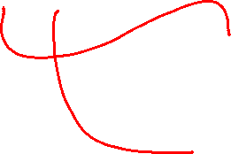
5.2 Repeated Multiplication-by-2
To convert decimal fractions to binary, repeated multiplication by 2 is used, until the fractional product is 0 (or until the desired number of decimal places). The carried digits, or carries, produce the answer, with the first carry as the MSB, and the last as the LSB.
(0.3125)₁₀ = ( ? )₂
.0101

Slide 14
6. Conversion Between Decimal and Other Bases
Base-R to decimal: multiply digits with their corresponding weights
Decimal to binary (base 2)
Whole numbers: repeated division-by-2
Fractions: repeated multiplication-by-2
Decimal to base-R
Whole numbers: repeated division-by-R
Fractions: repeated multiplication-by-R
DLD page 42 Quick Review Questions Questions 2-5 to 2-8.

Slide 15
7. Conversion Between Bases
In general, conversion between bases can be done via decimal:
Base-2 Base-2
Base-3 Base-3
Base-4 Decimal Base-4
… ….
Base-R Base-R
Shortcuts for conversion between bases 2, 4, 8, 16 (see next slide)

Slide 16
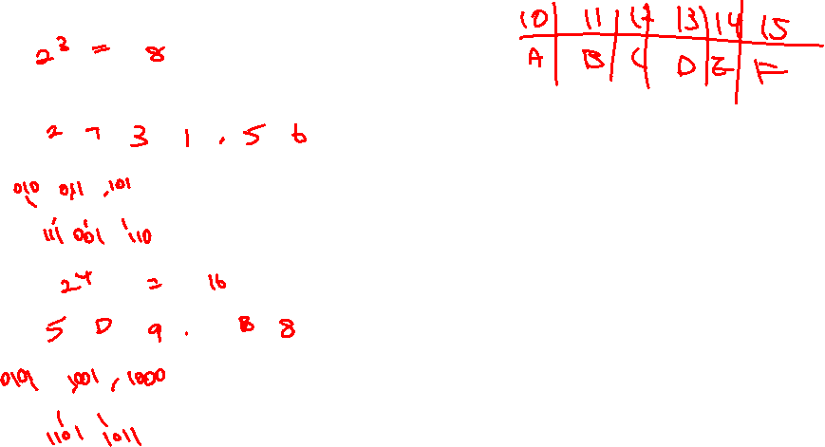
8. Binary to Octal/Hexadecimal Conversion
Binary → Octal: partition in groups of 3
(10 111 011 001 . 101 110)₂ =
Octal → Binary: reverse
(2731.56)₈ =
Binary → Hexadecimal: partition in groups of 4
(101 1101 1001 . 1011 1000)₂ =
Hexadecimal → Binary: reverse
(5D9.B8)₁₆ =
(2731.56)₈
(10 111 011 001 . 101 110)₂
(5D9.B8)₁₆
(101 1101 1001 . 1011 1000)₂
DLD page 42 Quick Review Questions Questions 2-9 to 2-10.


Slide 17
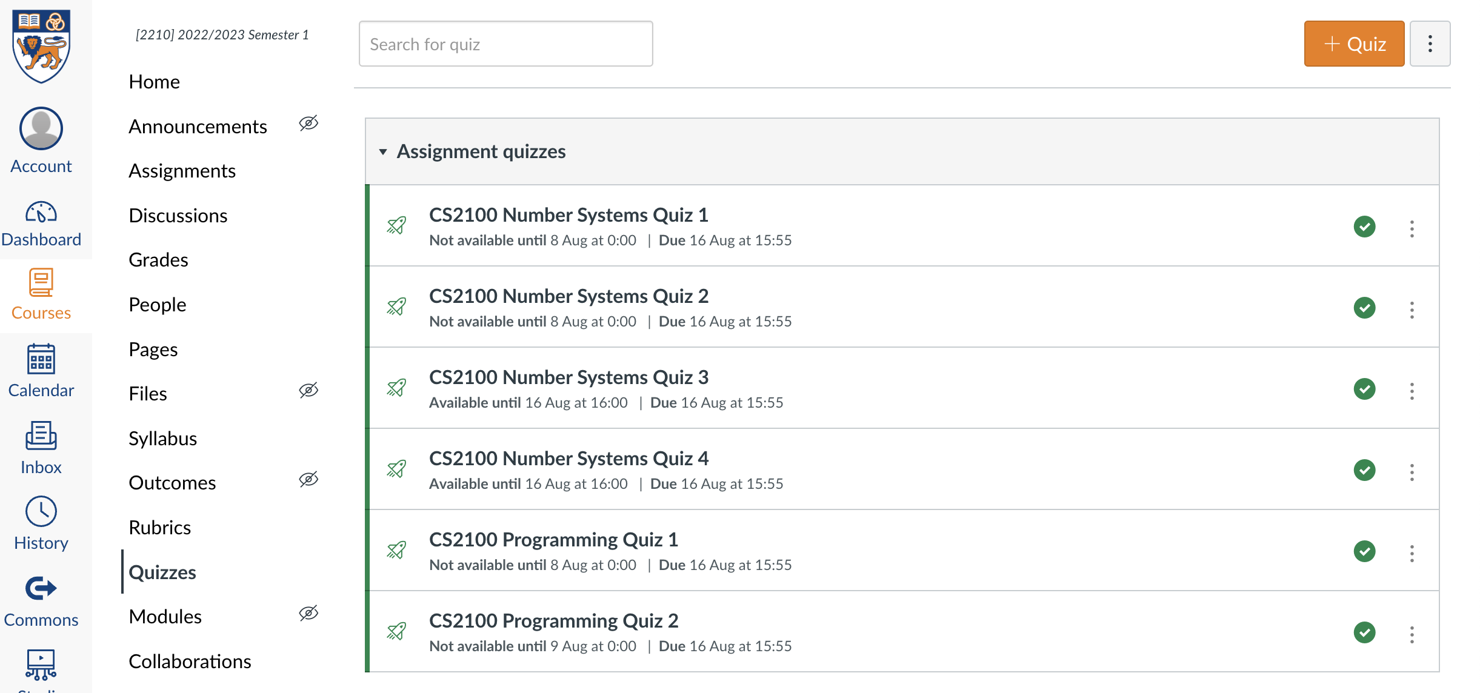
Quiz
Please complete the “CS2100 C Number Systems Quiz 1” in Canvas.
Access via the “Quizzes” tool in the left toolbar and select the quiz on the right side of the screen.

Slide 18
End of File

